Slide 1
DATa science final project
Usage of data to analyze a new venue location in the city of madrid

Slide 2
Business understanding
This final project aims to solve the problem of opening a new restaurant in the city of Madrid, Spain.
Currently, there is no specific type of restaurant, as first we would like to know what types of restaurants can be encountered in the different neighbourhoods of the city.

Slide 3
Data requirements
The data to take a decision on what type of restaurant and what neighbourhood to choose will be a database generated from the information available at Foursquare.
Once the data is obtained, a map will be generated representing the neighbourhoods of Madrid and a study on the density of restaurants will be conducted.

Slide 4
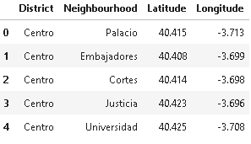
Data collection
An excel table was made with the districts and neighbourhoods. Added to that, each latitude and longitude.

Slide 5
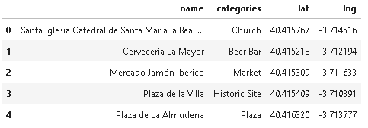
Subsequently, using Foursquare, the information of the venues from each neighbourhood was obtained.
Basic information such as name, category and coordinates was added.

Slide 6
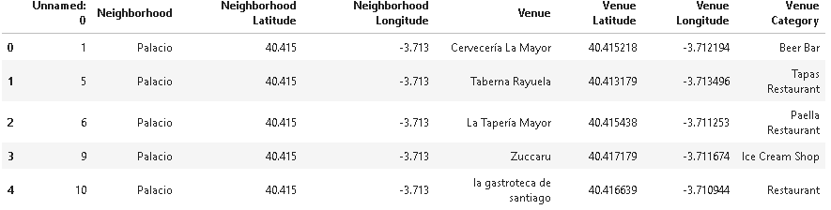
Data cleaning
Foursquare provided with all the venues of each neighbourhood. For this data analysis, only venues such as restaurants, cafes, bars and similar will be considered to be part of the dataset.
Therefore, venues such as churches, parks, theatres, etc. were deleted.

Slide 7
Data preparation
The are 110 categories of venues after the data cleaning.
To make the analysis simpler, the venue categories will be classified in subgroups.

Slide 8
Venues
Places to drink
Local Spanish
Dessert venues
International food
Special venue
Fast food
Vegan
Pet café
Gay bar
Latino
Asian
European
American
Middle East
African
Pubs
Taverna
Wine Bar
Tapas
Paella
Seafood
Cupcakes
Tea rooms
Ice cream
Burger joint
Fried chicken
Salad place

Slide 9




Further PReparation
However, the subcategories of international food are yet not specific enough. As for example, Mexican food is different from Argentinian. Or, Italian is different to Eastern European or Slavic.
Therefore subsets of international food are made.

Slide 10
Madrid_latino
Peruvian Restaurant
Latin American Restaurant
Madrid_asian
Dumpling Restaurant
Ramen Restaurant
madrid_European
Persian Restaurant
Middle Eastern Restaurant
Madrid_middleeast
French Restaurant
Mexican Restaurant
Mediterranean Restaurant
Argentinian Restaurant
Sushi Restaurant
Vietnamese Restaurant
Thai Restaurant
Italian Restaurant
Asian Restaurant
Indian Restaurant
Japanese Restaurant
Cuban Restaurant
Noodle House
Creperie
madrid_American
Madrid_African
African Restaurant
Hawaiian Restaurant
Moroccan Restaurant
Chinese Restaurant
Cajun / Creole Restaurant
Burrito Place
Bistro
Modern European Restaurant
Arepa Restaurant
Korean Restaurant
Falafel Restaurant
Portuguese Restaurant
Salvadoran Restaurant
Polish Restaurant
Greek Restaurant
Turkish Restaurant
Taco Place
South American Restaurant
Brazilian Restaurant
Eastern European Restaurant
German Restaurant
Lebanese Restaurant
Kebab Restaurant
American Restaurant

Slide 11

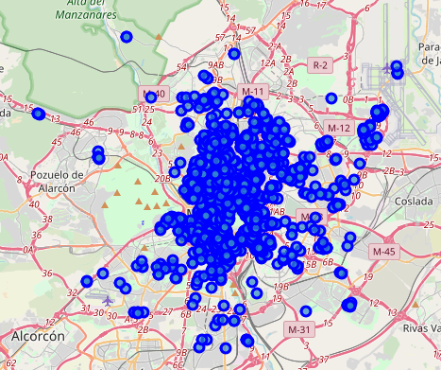
Data Visualization
Once classified all venues in Madrid, it is possible to visualize in a map the concentration of restaurants of a certain category.

Slide 12

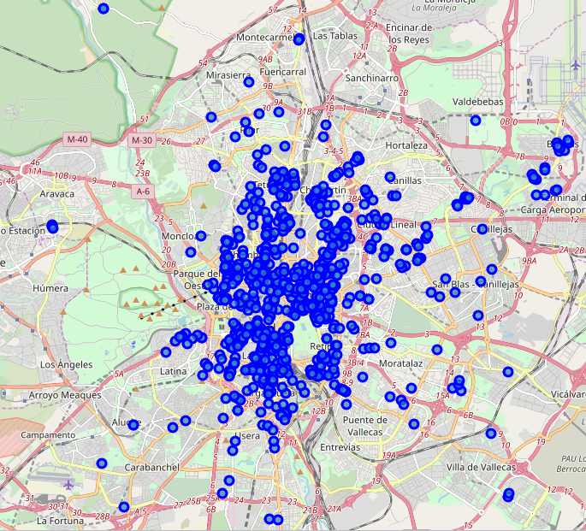
Map of typical Spanish venues
They are everywhere in the main city and in the outskirts. Its not hard to find one in the province of Madrid.

Slide 13
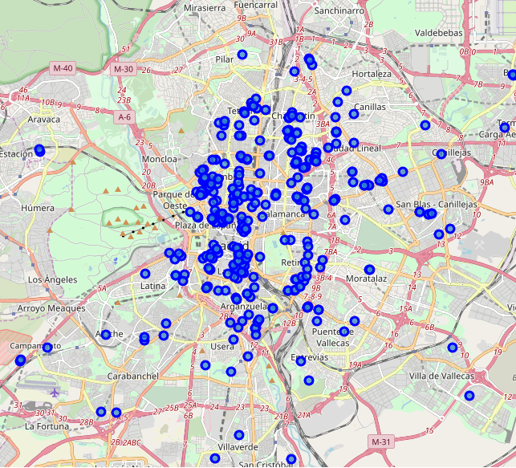
Map of drinking places
The vast majority of establishments are in the main city, on the outskirts there is a lower concentration.
However, it its important to notice that Spanish local venues serve drinks.

Slide 14
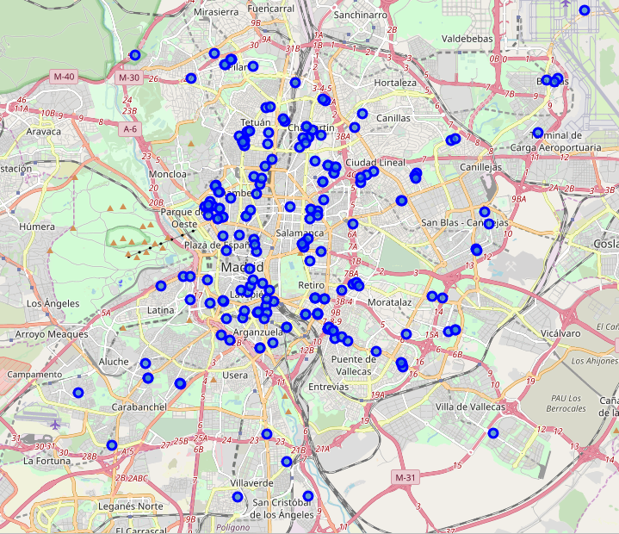
Map of fast food venues
It is evident that there is a low amount of fast food venues in the south of Madrid.

Slide 15
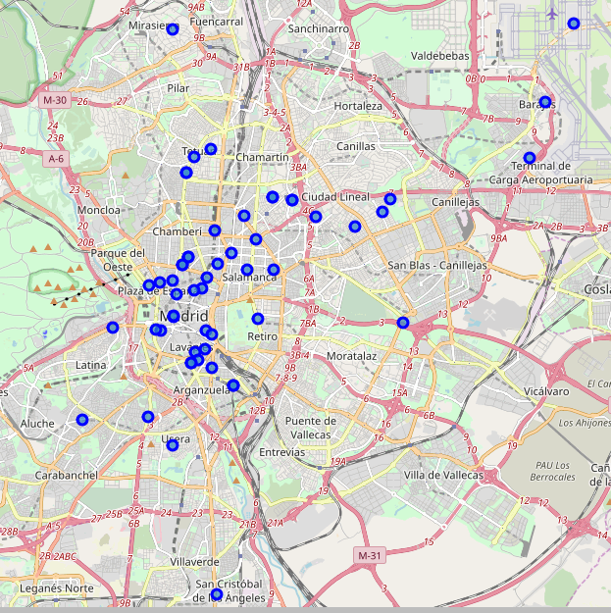
Special type
They can be found mainly in the centre and northern upstate districts of Madrid.

Slide 16
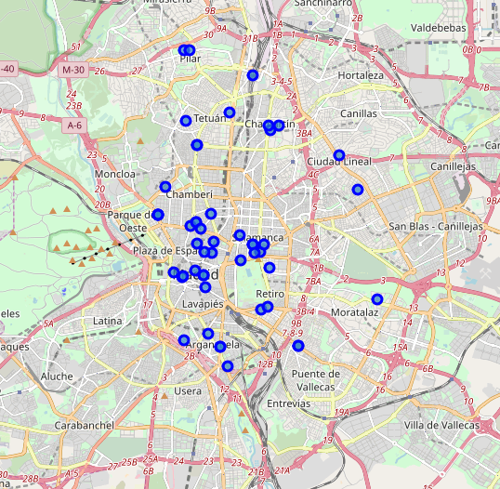
Dessert venues
It is evident that they can mainly be found in the city centre.

Slide 17
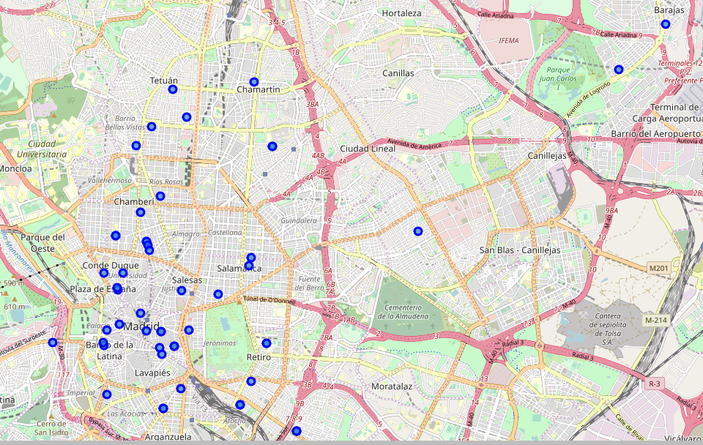
Latino type venues
Can be found mainly in the city centre as well as the upscale districts.

Slide 18
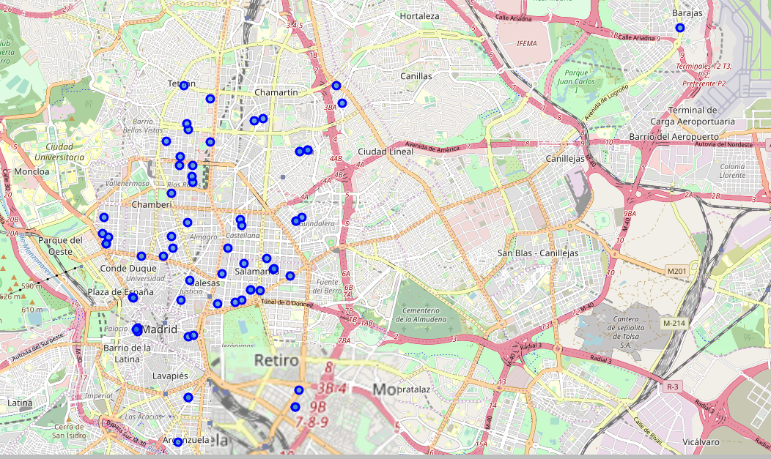
Asian establishments
Can be found generally in the city centre and upstate districts.
Opening a venue in the outskirts and suburbs could be a good opportunity.

Slide 19
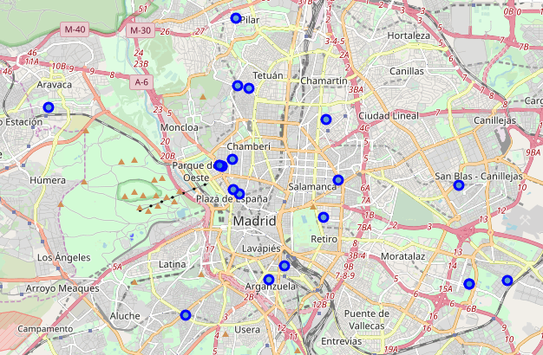
American Style Venues
They are only concentrated in upstate districts. However, they seem to be very stretched out.

Slide 20
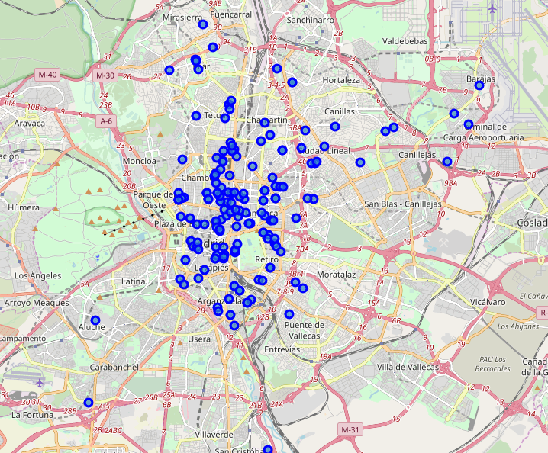
European establishments
Concentrated in the city centre and upstate distrcits.
It is hard to find one in the south of the city, enabling a business opportunity.

Slide 21
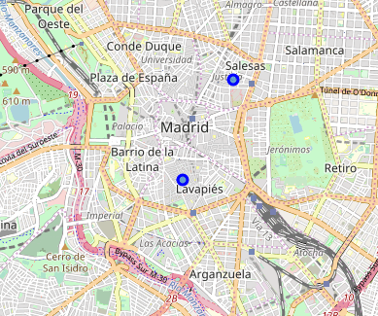
African venues
Unfortunately only two venues can be found in all the city.
This shows a great business opportunity to open one in the city centre, as there is no competition from other African style restaurants.

Slide 22
Conclusion
Opening a typical Spanish venue has a lot of competition, a great key difference would be essential to be competitive.
Fast food is common, however, location is essential.
Asian style gives a good opportunity, nevertheless, as fast food, location is key.
Latino and American restaurants offer a better opportunity in contrast to Asian cuisine, as they are sparsely separated through the city. A good location would be on the north and east side of the city.

